Slide 1
Annotation Strategies & Machine Language
Annotation Strategies, Machine Languages, Control Flow of Computer Instructions, Hack Assembly

Slide 2
Do the current times for CSE 390B office hours fit well with your schedule? If not, which days and times for CSE 390B office hours would work better for you?

Slide 3
CSE 390B Logistics
Please email the course staff if you need to attend office hours on Zoom
Your grade on Gradescope is your raw score (i.e., doesn’t take into account lateness deductions)
  Lateness deductions will be factored into the Canvas assignment
You can check your late days remaining in the Canvas assignment titled “Late Days Remaining”
Project 4 Cornell notes should be for a class aside from CSE 390B

Slide 4
Lecture Outline
Strategies for Annotating Texts
  Motivation and Techniques for Annotation
Machine Languages
  Assembly Languages, Producing Machine Code
Control Flow of Computer Instructions
  Jumps in Assembly, The Program Counter
The Hack Assembly Language
  Registers, A-Instructions, Symbols, & C-Instructions

Slide 5
Cornell Note-taking Follow-up Discussion
In groups of 3-4, discuss the following about the Cornell notes you took from last Thursday’s lecture:
What are some of the key points you wrote in your summary?
What were some of the questions you came up with?
What are you still left feeling confused or uncertain about after Thursday’s lecture?

Slide 6

Annotating Your Texts
WHY DO WE CARE?!
WHAT
Intentionality of interacting with a text to enhance the reader's understanding of, recall of, and reaction to the text

Slide 7
Annotating Your Texts
WHY DO WE CARE?!
WHAT
Intentionality of interacting with a text to enhance the reader's understanding of, recall of, and reaction to the text
HOW
  Highlighting, underlining or using [brackets] to note key points or ideas

Slide 8
Annotating Your Texts
WHY DO WE CARE?!
WHAT
Intentionality of interacting with a text to enhance the reader's understanding of, recall of, and reaction to the text
HOW
  Highlighting, underlining or using [brackets] to note key points or ideas
  Circling unfamiliar words or confusing parts of the text

Slide 9
Annotating Your Texts
WHY DO WE CARE?!
WHAT
Intentionality of interacting with a text to enhance the reader's understanding of, recall of, and reaction to the text
HOW
  Highlighting, underlining or using [brackets] to note key points or ideas
  Circling unfamiliar words or confusing parts of the text
  Paraphrasing or summarizing passages/chapters/sections

Slide 10
Annotating Your Texts
WHY DO WE CARE?!
WHAT
Intentionality of interacting with a text to enhance the reader's understanding of, recall of, and reaction to the text
HOW
  Highlighting, underlining or using [brackets] to note key points or ideas
  Circling unfamiliar words or confusing parts of the text
  Paraphrasing or summarizing passages/chapters/sections
  Commenting or reacting to the text 🤯

Slide 11
Lecture Outline
Strategies for Annotating Texts
  Motivation and Techniques for Annotation
Machine Languages
  Assembly Languages, Producing Machine Code
Control Flow of Computer Instructions
  Jumps in Assembly, The Program Counter
The Hack Assembly Language
  Registers, A-Instructions, Symbols, & C-Instructions

Slide 12

Revisiting The Von Neumann Architecture
(This picture will get more detailed as we go!)
COMPUTER
MEMORY
CPU
PROGRAM
INPUT
OUTPUT
DATA
REGISTERS
CONTROL

Slide 13
Machine Code
Instructions are stored in memory, so they must be able to be encoded in binary
When we refer to machine code, we are typically talking about this binary representation of code
Each instruction is a sequence of 0s and 1s
  Our computer / hardware specification is what gives meaning to each part of this sequence
  “Is this an add or subtract instruction? What are the inputs?”

Slide 14
Storing the Program
(This picture will get more detailed as we go!)
COMPUTER
MEMORY
CPU
0
1
2
0101110011100110
1011000101010100
1110001011111100
...
Instructions
INPUT
OUTPUT
n
n+1
n+2
1100101010010101
1100100101100111
0011001010101011
...
Data
REGISTERS
CONTROL

Slide 15
Assembly Languages
Writing code using 0s and 1s is tedious and error prone
Assembly languages are a human-readable format of binary instructions that a CPU runs
Each human-readable assembly instruction has a corresponding binary machine code instruction
  Example: addq reg1, reg2 == 0b1011000101010100
Assembly is often used as an intermediary between a high-level programming language and machine code

Slide 16
Producing Machine Code
while (i < 100) {
sum += arr[i];
i++;
}
Java
Compile
MEMORY
CPU
0101110011100110
1011000101010100
1110001011111100
...
Machine Code Instructions
PROGRAM
DATA
Load & Execute
REGISTERS
CONTROL
16

Slide 17
Producing Machine Code
while (i < 100) {
sum += arr[i];
i++;
}
Java
Compile
MEMORY
CPU
0101110011100110
1011000101010100
1110001011111100
...
Machine Code Instructions
PROGRAM
DATA
Load & Execute
REGISTERS
CONTROL
movq $5, %rdx
addq %rsx, %rdx
movq %rdx, %rax
ret
Assembly Language
Assemble
17

Slide 18
Producing Machine Code
while (i < 100) {
sum += arr[i];
i++;
}
Java
Compile
MEMORY
CPU
0101110011100110
1011000101010100
1110001011111100
...
Machine Code Instructions
PROGRAM
Compile
DATA
Load & Execute
REGISTERS
CONTROL
movq $5, %rdx
addq %rsx, %rdx
movq %rdx, %rax
ret
Assembly Language
Assemble
18

Slide 19
Machine Language
Specification of the Hardware / Software interface
  What operations are supported?
  What do they operate on?
  How is the program controlled?
Usually in close correspondence with the hardware architecture
  Different specification for different hardware platforms
Cost and Performance Tradeoffs
  Silicon area and complexity
  Time to complete instruction
  Power consumption

Slide 20
Machine Operations
Correspond to the operations supported by hardware:
  Arithmetic (+, –)
  Logical (And, Or)
  Flow Control (“go to instruction n”, “if (condition) then go to instruction n”)
Differences between machine languages:
  Instruction set richness (e.g., division? bulk copy?)
  Data types (e.g., word size, floating point)

Slide 21
Registers
CPU
CPU typically has a small number of registers
  Very efficient to access
  Used for intermediate, short-term “scratch work”
Number and use of registers is a central part of any machine language
REGISTERS
rsp
0101110011100110
reg2
0101110011100110
D
0101110011100110
CONTROL
21

Slide 22
Addressing Modes
“What locations can I specify in my assembly code?”
Some useful options:
  Register
    add reg1, reg2
  Direct Memory Access
    add reg1, Memory[200]
  Indirect Memory Access
    add reg1, Memory[reg2]
  Immediate
    add 100, reg2
Register names
Access the giant array (i.e., memory) at index 200

Slide 23

Five-minute Break!
Feel free to stand up, stretch, use the restroom, drink some water, review your notes, or ask questions
We’ll be back at:

Slide 24
Lecture Outline
Strategies for Annotating Texts
  Motivation and Techniques for Annotation
Machine Languages
  Assembly Languages, Producing Machine Code
Control Flow of Computer Instructions
  Jumps in Assembly, The Program Counter
The Hack Assembly Language
  Registers, A-Instructions, Symbols, & C-Instructions

Slide 25
Flow Control
COMPUTER
Which instruction should execute next?
MEMORY
CPU
0
1
2
0101110011100110
1011000101010100
1110001011111100
...
Instructions
INPUT
OUTPUT
n
n+1
n+2
1100101010010101
1100100101100111
0011001010101011
...
Data
REGISTERS
CONTROL
PC
1
25

Slide 26
Flow Control: Unconditional Jumps
Usually, the CPU just executes machine instructions in a sequence
  Typically moves to the instruction with the next highest address
Sometimes we want to always “jump” to another location
  Example: At the end of an infinite loop
High Level Code (similar to Java) | Assembly Code
while (true) { reg1++; <more loop body> } <code after loop> | TOP: add 1, reg1 <more loop body> jmp TOP <code after loop>

Slide 27
Flow Control: Conditional Jumps
Usually, the CPU just executes machine instructions in a sequence
  Typically moves to the instruction with the next highest address
Sometimes we want to “jump” only if a condition is met
  Example: At the condition of an if statement
High Level Code (similar to Java) | Assembly Code
if (reg1 < reg2) { reg1++; } reg2++; | cmp reg1, reg2 jge SKIP add 1, reg1 SKIP: add 1, reg2

Slide 28
Program Counter (PC)
Memory is used to store data as well as code
Instructions and operations are stored at different addresses in memory
Program Counter in the CPU keeps track of which address contains the instruction that should be executed next
COMPUTER
MEMORY
Data and instructions
CPU
Program Counter (which line of code should I execute)

Slide 29
Program Counter (PC)
Keeps track of what instruction we are executing
  If the PC outputs 24, on the next clock cycle the computer runs the instruction at address 24 in the code segment
Next cycle, replace counter value with in
(E.g., method calls)
Next cycle, add 1 to counter value
(E.g., normal operation)
Next cycle, set counter to 0
(E.g., program start)
load
inc
reset
in
PC
out
16
16

Slide 30
Program Counter (PC)
Keeps track of what instruction we are executing
  If the PC outputs 24, on the next clock cycle the computer runs the instruction at address 24 in the code segment
Program counter specification:
if (reset[t] == 1) out[t+1] = 0
else if (load[t] == 1) out[t+1] = in[t]
else if (inc[t] == 1) out[t+1] = out[t] + 1
else out[t+1] = out[t]
load
inc
reset
in
PC
out
16
16

Slide 31
Lecture Outline
Strategies for Annotating Texts
  Motivation and Techniques for Annotation
Machine Languages
  Assembly Languages, Producing Machine Code
Control Flow of Computer Instructions
  Jumps in Assembly, The Program Counter
The Hack Assembly Language
  Registers, A-Instructions, Symbols, & C-Instructions

Slide 32
The Hack Computer
The hardware you will build
  16-bit word size
  ROM: sequence of instructions
    ROM[0], RAM[1]…
  RAM: data sequence
    RAM[0], RAM[1]…
COMPUTER
MEMORY
CPU
ROM
(16-bit Instructions, Read-Only)
1110001011111100
REGISTERS
RAM
(16-bit Data, Read/Write)
1100101010010101
A/M
D
SCREEN
CONTROL
KEYBOARD
PC
32

Slide 33
The Hack Machine Language
Two types of instructions (16-bit)
  A-instructions load data
  C-instructions perform computations
Program: sequence of instructions
COMPUTER
MEMORY
CPU
ROM
(16-bit Instructions, Read-Only)
1110001011111100
REGISTERS
RAM
(16-bit Data, Read/Write)
1100101010010101
A/M
D
SCREEN
CONTROL
KEYBOARD
PC
33

Slide 34
Hack: Control Flow
Startup
  Hack instructions loaded into ROM
  Reset signal initializes computer state (instruction 0)
Execution
  Usually, advance to next instruction each cycle
  On jump instruction, write a different address into the PC
0
1
2
3
4
5
6
7
...
0101110011100110
1011000101010100
1110001011111100
0101110101101110
0001011000111010
0010111011011001
0110111110101001
0001110010110110
ROM (Instructions)

Slide 35
Hack: Registers
D Register: For storing Data
A Register: For storing data and Addressing memory
M “Register”: The 16-bit word in Memory currently being referenced by the address in A
RAM
1100101010010101
...
106
107
108
109
110
...
REGISTERS
M
A
108
D

Slide 36
Hack: A-Instructions
Syntax:
value can either be:
  A non-negative decimal constant
  A symbol referring to a constant
Semantics:
  Stores value in the A register
@value

Slide 37
Hack: A-Instructions
Symbolic Syntax
  Loads a value into the A register
Example:
Binary Syntax
@value
0000000000010101
Family:
A-Instruction
Value:
Binary encoding of 21
A Register
D Register
...
@21
...
0
0
A Register
D Register
21
0

Slide 38
Hack: Symbols
Symbols are simply an alias for some address
  Only in the symbolic code—don’t turn into a binary instruction
  Assembler converts use of that symbol to its value instead
Example:
LOOP = 02
00
01
02
03
04
@3
D=0
(LOOP)
@21
D=1
@LOOP
...
00
01
02
03
04
0000000000000011
1110101010010000
0000000000010101
1110111111010000
0000000000000010
...
Assemble

Slide 39
Hack: Built-In Symbols
Using ( ) defines a symbol in ROM / Instructions
Assembler knows a few built-in symbols in RAM / Data
R0, R1, ..., R15: Correspond to addresses at the very beginning of RAM (0, 1, …, 15)
  “Virtual registers,” Useful to store variables
SCREEN, KBD: Base of I/O Memory Maps
Example:
A Register
D Register
...
@R3
...
0
0
A Register
D Register
3
0

Slide 40
Hack: C-Instructions
Syntax: (dest and jump optional)
  dest is a combination of destination registers:
  comp is a computation:
  jump is an unconditional or conditional jump:
Semantics:
  Computes value of comp
  Stores results in dest (if specified)
  If jump is specified and condition is true (by testing comp result), jump to instruction ROM[A]
dest = comp ; jump
M, D, MD, A, AM, AD, AMD
0, 1, -1, D, A, !D, !A, -D, -A, D+1, A+1, D-1, A-1, D+A, D-A, A-D, D&A, D|A, M, !M, -M, M+1, M-1, D+M, D-M, M-D, D&M, D|M
JGT, JEQ, JGE, JLT, JNE, JLE, JMP

Slide 41
Hack: C-Instructions
Symbolic:
Binary:
dest = comp ; jump
1 1 1 a c1 c2 c3 c4 c5 c6 d1 d2 d3 j1 j2 j3
Family:
C-Instruction
Unused
Comp:
ALU Operation (a bit chooses between A and M)
Dest:
Where to store result
Jump:
Condition for jumping

Slide 42
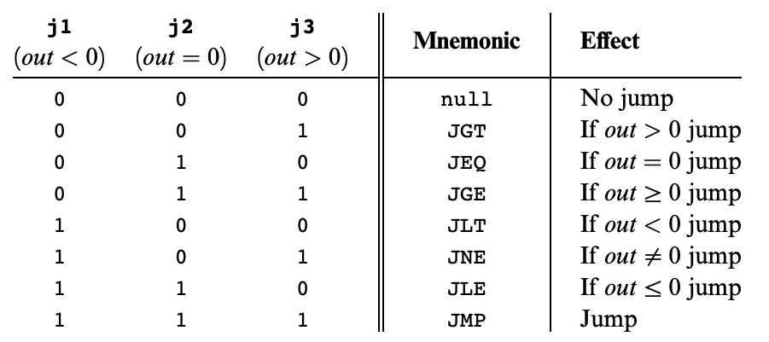
Hack: C-Instructions
Symbolic:
Binary:
dest = comp ; jump
1 1 1 a c1 c2 c3 c4 c5 c6 d1 d2 d3 j1 j2 j3
Jump:
Condition for jumping
Chapter 4

Slide 43
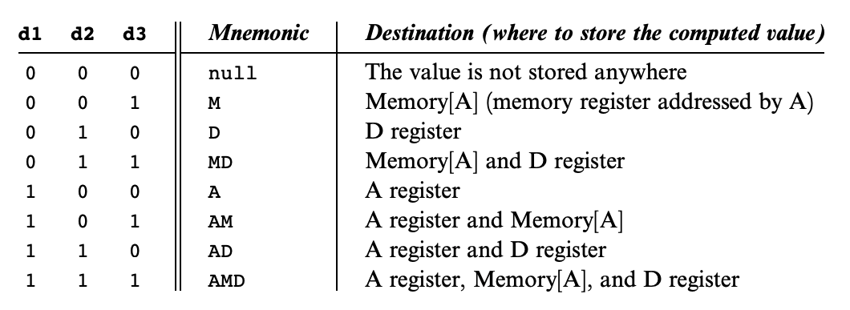
Hack: C-Instructions
Symbolic:
Binary:
dest = comp ; jump
1 1 1 a c1 c2 c3 c4 c5 c6 d1 d2 d3 j1 j2 j3
Dest:
Where to store result
Chapter 4

Slide 44
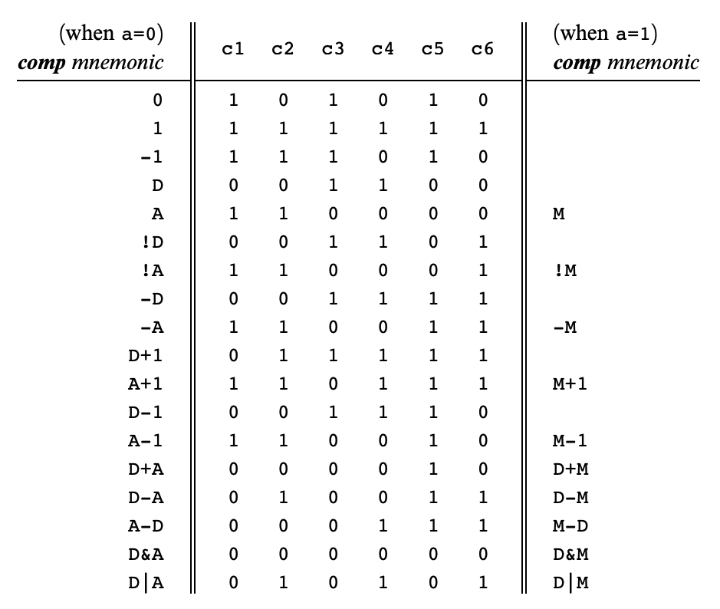
Hack: C-Instructions
Symbolic:
Binary:
dest = comp ; jump
1 1 1 a c1 c2 c3 c4 c5 c6 d1 d2 d3 j1 j2 j3
Comp:
ALU Operation (a bit chooses between A and M)
Chapter 4
Important: just pattern matching text!
Cannot have “1+M”

Slide 45
Hack: C-Instructions Example
A Register
D Register
55
56
00
01
(EXAMPLE)
@55
D=A+1

Slide 46
Hack: C-Instructions Example
A Register
D Register
55
56
00
01
02
03
(EXAMPLE)
@55
D=A+1
@R2
M=D
RAM
0
?
A Register
D Register
1
?
2
56
2
56
...

Slide 47
Hack: C-Instructions Example
A Register
D Register
55
56
00
01
02
03
04
05
(EXAMPLE)
@55
D=A+1
@R2
M=D
@EXAMPLE
D;JGT
RAM
0
?
A Register
D Register
1
?
2
56
2
56
...
A Register
D Register
0
56
(Will jump to instruction 0, since D > 0)

Slide 48
Post-Lecture 8 Reminders
We will explore Hack Assembly in lecture this Thursday!
Project 4 due this Thursday (10/27) at 11:59pm
Preston has office hours after class in CSE2 153
  Feel free to post your questions on the Ed board as well
Midterm exam coming up in around two weeks (11/10) during lecture time
  More details to come, along with metacognitive strategies for preparing for exams

